Slide 1
Procedure Text

Slide 2
Definition
Procedure text is a text that’s designed to describe or to tells the processes in a sequence of steps

Slide 3
Generic Structure
Goal
Materials (not required for all procedural texts).
Steps (goal Followed by a series of steps oriented to achieving the Goal

Slide 4
Significant lexicorgrammatical features
Focused on generalized human agents.
Use of simple present tense, often imperative
Use mainly of temporal conjunctions(or numbering to indicate sequence)
Use Mainly of Material Processes

Slide 5
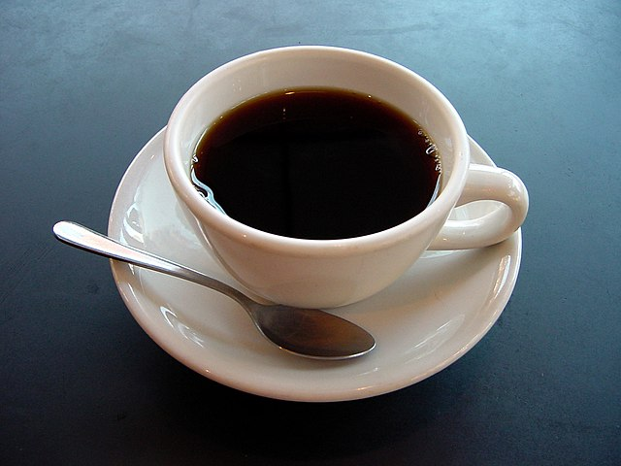
How To Make a Cup of Coffee

Slide 6
Ingredients: 1. Coffee powder 2. Sugar 3. A glass of water
Steps:
Boil the water in a pan or pot.
Prepare a cup.
Put 2 teaspoons of coffee powder and 2 teaspoons of
sugar or as your taste into the cup
Then, pour the boiled water into the cup and stir it well.
Wait for about 3 minutes.
Your cup of coffee is now ready to serve.

Slide 7
Language Features
• Contains "adverbial of sequence" (to point out each single step correctly)Example: First, second, then.....
• Must be using imperative commands (since the text is telling/commands people to do something)Example: cut the meat, slice the onion
• Contains "adverb of detailed time" (to tell you when to do or how long should you do something)Example: steam the potatoes for 30 minutes...
• Use of simple present tense(simple present tense could be used to describe people or things in general, other than habits, etc.)
• Contains "action verb" within

Slide 8
Because in the procedure text contains steps and materials. To tell the readers on how to make/do something
Why is it called procedure text?

